Slide 1

- SOFTWARE ENGINEERING AND PROJECT MANAGEMENT

Slide 2

UNIT III - Software Project Management
Project Management Principles, Process and Project Metrics, Function Point analysis, LOC, Make/Buy Decision, COCOMO II -Project Planning, SWOT analysis, Functions of manager, Team building & development, Risk Management.

Slide 3

Project Management

Slide 4
Software Project Management
Concerned with activities involved in ensuring that software is delivered
on time
within the budget
in accordance with the requirements
Project management is needed because software development is always subject to budget, requirement and schedule constraints that are set by the development organisation or the customer
Notes:
https://www.lucidchart.com/blog/5-Universal-Project-Management-Principles

Slide 5
Project Management
Organising, planning and scheduling software projects
Objectives
To introduce software project management and to describe its distinctive characteristics
To discuss project planning and the planning process
To show how graphical schedule representations are used by project management
To discuss the notion of risks and the risk management process
Notes:
25 Sep 2010
The Six Principles of Project Management
~ By Theo Gilbert-Jamison
Right now project management certification is all the rave, but I have been using a similar change model for quite some time with great success. It's called the 'Six Principles of Service Excellence', and it transitions easily to basically any type of project or initiative you are trying to effectively implement. For the project management aficionados and novices out there, think of it as the six principles of project management.
As a Performance Consultant, I regularly use these basic principles when launching a new initiative or learning and development programme, and especially when integrating new HR, Quality or, Operational Improvement Processes.
Principle 1: Vision and Mission
In order to be successfully executed, every project or initiative should begin with the end in mind. This is effectively accomplished by articulating the Vision and Mission of the project so it is crystal-clear to everyone. Creating a vision and mission for the project helps clarify the expected outcome or desired state, and how it will be accomplished.
Principle 2: Business Objectives
The next step is to establish two to three goals or objectives for the project. Is it being implemented to increase sales and profit, customer loyalty, employee productivity and morale, or product/service quality? Also, it's important to specifically quantify the amount of improvement that is expected, instead of being vague.
Principle 3: Standards of Engagement
Simply put, this means establishing who will be part of the project team? What will be the frequency of meetings? What are the meeting ground rules? Who is the project owner? Who is designated to take notes, and distribute project meeting minutes and action steps? This goes along with any other meeting protocol that needs to be clarified.
Principle 4: Intervention and Execution Strategy
This is the meat of the project and includes using a gap analysis process to determine the most suited intervention (solution) to resolve the issue you are working on. There are many quality management concepts that can be applied ranging from a comprehensive "root cause analysis" to simply "asking why five times." Once the best possible intervention has been identified to resolve the issue, then we must map out our execution strategy for implementing the intervention. This includes identifying who will do what, when, how, and why?
Principle 5: Organizational Alignment
To ensure the success and sustainability of the new initiative or process brought on by this project, everyone it will directly impact must be onboard. To achieve organizational alignment (or buy-in), ongoing communication must be employed in-person during team meetings, electronically via email and e-learning (if applicable), and through training. The message must include the WIIFM "what's in it for me" at every level; otherwise most stakeholders will not be interested or engaged around the new initiative.
Principle 6: Measurement and Accountability
And last, how will we determine success? Well, a simple project scorecard that is visually interesting is a great way to keep everyone updated and engaged. A scorecard is an excellent resource for holding employees, teams, and leaders accountable for the implementation, refinement, and sustainability of the new initiative or project. Accountability means that consistently, top performers will be rewarded and recognized; while those needing improvement will be coached with specific expectations and consequences clearly outlined.
While my six principles of project management may not be all inclusive, my hope is that it has ignited creative juices as you think about how you will approach your next project - whether implementing a new system/process or refining one that is already in place to enhance its effectiveness

Slide 6
Management Activities
Proposal writing
Project planning and scheduling
Project costing
Project monitoring and reviews
Personnel selection and evaluation
Report writing and presentations
Notes:
25 Sep 2010
The Six Principles of Project Management
~ By Theo Gilbert-Jamison
Right now project management certification is all the rave, but I have been using a similar change model for quite some time with great success. It's called the 'Six Principles of Service Excellence', and it transitions easily to basically any type of project or initiative you are trying to effectively implement. For the project management aficionados and novices out there, think of it as the six principles of project management.
As a Performance Consultant, I regularly use these basic principles when launching a new initiative or learning and development programme, and especially when integrating new HR, Quality or, Operational Improvement Processes.
Principle 1: Vision and Mission
In order to be successfully executed, every project or initiative should begin with the end in mind. This is effectively accomplished by articulating the Vision and Mission of the project so it is crystal-clear to everyone. Creating a vision and mission for the project helps clarify the expected outcome or desired state, and how it will be accomplished.
Principle 2: Business Objectives
The next step is to establish two to three goals or objectives for the project. Is it being implemented to increase sales and profit, customer loyalty, employee productivity and morale, or product/service quality? Also, it's important to specifically quantify the amount of improvement that is expected, instead of being vague.
Principle 3: Standards of Engagement
Simply put, this means establishing who will be part of the project team? What will be the frequency of meetings? What are the meeting ground rules? Who is the project owner? Who is designated to take notes, and distribute project meeting minutes and action steps? This goes along with any other meeting protocol that needs to be clarified.
Principle 4: Intervention and Execution Strategy
This is the meat of the project and includes using a gap analysis process to determine the most suited intervention (solution) to resolve the issue you are working on. There are many quality management concepts that can be applied ranging from a comprehensive "root cause analysis" to simply "asking why five times." Once the best possible intervention has been identified to resolve the issue, then we must map out our execution strategy for implementing the intervention. This includes identifying who will do what, when, how, and why?
Principle 5: Organizational Alignment
To ensure the success and sustainability of the new initiative or process brought on by this project, everyone it will directly impact must be onboard. To achieve organizational alignment (or buy-in), ongoing communication must be employed in-person during team meetings, electronically via email and e-learning (if applicable), and through training. The message must include the WIIFM "what's in it for me" at every level; otherwise most stakeholders will not be interested or engaged around the new initiative.
Principle 6: Measurement and Accountability
And last, how will we determine success? Well, a simple project scorecard that is visually interesting is a great way to keep everyone updated and engaged. A scorecard is an excellent resource for holding employees, teams, and leaders accountable for the implementation, refinement, and sustainability of the new initiative or project. Accountability means that consistently, top performers will be rewarded and recognized; while those needing improvement will be coached with specific expectations and consequences clearly outlined.
While my six principles of project management may not be all inclusive, my hope is that it has ignited creative juices as you think about how you will approach your next project - whether implementing a new system/process or refining one that is already in place to enhance its effectiveness

Slide 7

Failed Projects : Airbus A380
Building the Airbus A380—the world’s largest commercial aircraft at the time—required production facilities from across the globe to build individual parts of the aeroplane.
All teams used different computer-aided design (CAD) programs.
During installation, they discovered the parts designed by different teams didn’t fit together.
This cost the company $6 billion to put right and set the project back two years.

Slide 8

Failed Projects : Ford Edsel
Ford did extensive market research before it released the Edsel.
They spent 10 years and $250 million on research and planning—but by the time all this was completed, and the car was unveiled in 1957, Ford had missed its chance.
The market had already moved on to buying compact cars, which didn’t include the Edsel.

Slide 9

Failed Project: Ariane 5 Disaster
On June 4th, 1996, the very first Ariane 5 rocket ignited its engines and began speeding away from the coast of French Guiana.
37 seconds later, the rocket flipped 90 degrees in the wrong direction, and less than two seconds later, aerodynamic forces ripped the boosters apart from the main stage at a height of 4km.
This caused the self-destruct mechanism to trigger, and the spacecraft was consumed in a gigantic fireball of liquid hydrogen.

Slide 10
Failed Project: Ariane 5 Disaster
The fault was a software bug in the rocket’s Inertial Reference System. This system is used to determine whether it was pointing up or down, which is formally known as the horizontal bias.
This value was represented by a 64-bit floating variable, which was perfectly adequate.
However, when the software attempted to stuff this 64-bit variable, which can represent billions of potential values, into a 16-bit integer, which can only represent 65,535 potential values.
For the first few seconds of flight, the rocket’s acceleration was low, so the conversion between these two values was successful.
However, as the rocket’s velocity increased, the 64-bit variable exceeded 65k, and became too large to fit in a 16-bit variable.

Slide 11
A German pro basketball team was Failed Project : Relegated to a lower division due to a Windows update
In 2015, the Paderborn Baskets, a second division German basketball team, was relegated to a lower division for starting a game late, due to a necessary 17-minute Windows update to the scoreboard’s laptop.
The game between the Chemnitz Niners and the Paderborn Baskets was set to begin as normal, when Paderborn connected its laptop to the scoreboard. According to Paderborn Baskets general manager Patrick Seidel, as reported in the Die Zeit journal, the laptop was connected by 6:00 p.m. (meaning 1 hour and 30 minutes before the game), and was set “as usual.” However, according to Seidel, “As both teams warmed up, the computer crashed. When we booted it again by 7:20 p.m., it started downloading updates automatically.” When the computer finished downloading and installing all the updates, the game finally began at 7:55 p.m.
Paderborn won the game 69 to 62.
As a result, Paderborn lost a point as a penalty and found itself relegated from the ProA to the ProB division

Slide 12

A $2 billion air traffic control System Failed due to insufficient computer memory
On April 30, 2014, hundreds of LAX flights were delayed or canceled because all computers in the airport crashed due to a bug in the En Route Automation Modernization (ERAM) system.
The system failure was sparked due to a U-2 spy plane that was flying through the region.
The $2.4 billion system, made by Lockheed Martin Corp, cycled off and on trying to fix the error, which was due to a lack of altitude information in the airplane’s flight plan.
After an air traffic controller entered an estimated altitude of the plane, the system calculated all possible flight paths to ensure that it was not on a crash course with other planes.
However, that process caused the system to fall short in memory and shut down every other flight processing function. Fortunately, no injuries or accidents were reported.
The ERAM system failed because it limits how much data each plane can send. Most planes have simple flight plans, so they do not exceed that limit. However, the U-2 operating that day had a complex flight plan that brought it close to the system’s limit.

Slide 13
Project Management Principles

Slide 14
5 Project Management Principles
Address important questions at the beginning of the project
Sketch out a scope and goals for your project
Communicate roles, expectations, and objectives to the team
Monitor progress and identify roadblocks
Make sure all deliverables have been met and finalize the project

Slide 15
Project Management Principles
Address important questions at the beginning of the project
Should this project happen and how will it help the company?
Can the company benefit from this project at this time?
What problem is this project solving?
Sketch out a scope and goals for your project
What is this project’s main goal and deliverables needed to reach that goal?
What risks exist for this project, and how can you avoid them?
What is the scope of this project and how will you manage expanding priorities and changing workloads if they happen mid-project
Communicate roles, expectations, and objectives to the team
The progress you’ve made along the project timeline
The goals and advantages of the project
The project’s roadblocks and successes
Monitor progress and identify roadblocks
Do all team members understand the expectations and is the project on time?
What roadblocks exist? How can you remove them for your team?
Are you communicating and staying organized?
Does the project need to be redirected from its original scope?
Make sure all deliverables have been met and finalize the project
Have all deliverables been met?
Were all deliverables carried out to a standard of quality the team is proud of?
What did your team do well?
How could a project like this function better next time?
Notes:
25 Sep 2010
The Six Principles of Project Management
~ By Theo Gilbert-Jamison
Right now project management certification is all the rave, but I have been using a similar change model for quite some time with great success. It's called the 'Six Principles of Service Excellence', and it transitions easily to basically any type of project or initiative you are trying to effectively implement. For the project management aficionados and novices out there, think of it as the six principles of project management.
As a Performance Consultant, I regularly use these basic principles when launching a new initiative or learning and development programme, and especially when integrating new HR, Quality or, Operational Improvement Processes.
Principle 1: Vision and Mission
In order to be successfully executed, every project or initiative should begin with the end in mind. This is effectively accomplished by articulating the Vision and Mission of the project so it is crystal-clear to everyone. Creating a vision and mission for the project helps clarify the expected outcome or desired state, and how it will be accomplished.
Principle 2: Business Objectives
The next step is to establish two to three goals or objectives for the project. Is it being implemented to increase sales and profit, customer loyalty, employee productivity and morale, or product/service quality? Also, it's important to specifically quantify the amount of improvement that is expected, instead of being vague.
Principle 3: Standards of Engagement
Simply put, this means establishing who will be part of the project team? What will be the frequency of meetings? What are the meeting ground rules? Who is the project owner? Who is designated to take notes, and distribute project meeting minutes and action steps? This goes along with any other meeting protocol that needs to be clarified.
Principle 4: Intervention and Execution Strategy
This is the meat of the project and includes using a gap analysis process to determine the most suited intervention (solution) to resolve the issue you are working on. There are many quality management concepts that can be applied ranging from a comprehensive "root cause analysis" to simply "asking why five times." Once the best possible intervention has been identified to resolve the issue, then we must map out our execution strategy for implementing the intervention. This includes identifying who will do what, when, how, and why?
Principle 5: Organizational Alignment
To ensure the success and sustainability of the new initiative or process brought on by this project, everyone it will directly impact must be onboard. To achieve organizational alignment (or buy-in), ongoing communication must be employed in-person during team meetings, electronically via email and e-learning (if applicable), and through training. The message must include the WIIFM "what's in it for me" at every level; otherwise most stakeholders will not be interested or engaged around the new initiative.
Principle 6: Measurement and Accountability
And last, how will we determine success? Well, a simple project scorecard that is visually interesting is a great way to keep everyone updated and engaged. A scorecard is an excellent resource for holding employees, teams, and leaders accountable for the implementation, refinement, and sustainability of the new initiative or project. Accountability means that consistently, top performers will be rewarded and recognized; while those needing improvement will be coached with specific expectations and consequences clearly outlined.
While my six principles of project management may not be all inclusive, my hope is that it has ignited creative juices as you think about how you will approach your next project - whether implementing a new system/process or refining one that is already in place to enhance its effectiveness

Slide 16
People in the Project
Projects don’t get done by themselves. We need people to carry them out.
This is where project managers and project management team come into the picture. When we look at the project management life-cycle, there are many people and groups involved.
A project manager is a person who is responsible for leading the project. In other words, project managers are the spearheads of a project.
A project team is a group of individuals teamed together. Their purpose is to achieve a specific business task or goal.

Slide 17
Software Process & Project Metrics
Software process and project metrics are quantitative measures that enable software engineers to gain insight into the efficiency of the software process and the projects conducted using the process framework. In software project management, we are primarily concerned with productivity and quality metrics.
Software Measures: Lines of Code , Function Point

Slide 18
Metrics is a quantitative measure of the degree to which a system, component or a process possesses a given attribute. Software Metrics refers to a broad range of measurements for computer software. Project Metrics :relate to Project Quality. They are used to quantify defects, cost, schedule, productivity and estimation of various project resources and deliverables.
Software Metrics

Slide 19
Process and Project Metrics [1]
a) Process Metrics
These are metrics that pertain to Process Quality. They are used to measure the efficiency and effectiveness of various processes.
b) Project Metrics
These are metrics that pertain to Project Quality. They are used to quantify defects, cost, schedule, productivity and estimation of various project resources and deliverables.

Slide 20
Measurement can be applied to the software process with the intent of improving it on a continuous basis. Measurement can be used throughout a software project to assist in estimation, quality control, productivity assessment and project control.
Software Measurement

Slide 21
Software Measurement
Direct Measures- cost and efforts applied i.e.
Line of Code -LOC ,
Function Point -FP,
execution speed,
memory size,
defect reported.
Indirect Measures- quality, complexity, efficiency, reliability, maintainability.

Slide 22
Direct Measurement : Function Point (FP)
A function point calculates software size with the help of logical design and performance of functions as per user requirements.
It also helps in determining the business functionality of a software application.
It is derived from a software's requirements and can be estimated in the early phases of software development, before the actual lines of code can be determined.
The number of function points in a code depends on function complexity.
Measure software development and maintenance independently of technology used for implementation

Slide 23
Direct Measurement : Function Point (FP)
Since Function Points measures systems from a functional perspective they are independent of technology.
Regardless of language, development method, or hardware platform used, the number of function points for a system will remain constant.
The only variable is the amount of effort needed to deliver a given set of function points.

Slide 24
Five Components of Function Point
A. Data Function
Internal logic files
External Interface files
B. Transactional Functions
External Inputs
External Output
External Inquires

Slide 25
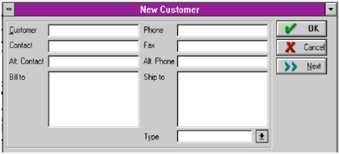

Slide 26
Components of Function Point – Data Points
ILF
EIF
Internal Logical Files (ILF’s) - a user identifiable group of logically related data that resides entirely within the applications boundary and is maintained through external inputs.
External Interface Files (EIF’s) - a user identifiable group of logically related data that is used for reference purposes only. The data resides entirely outside the application and is maintained by another application. The external interface file is an internal logical file for another application.

Slide 27
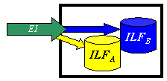
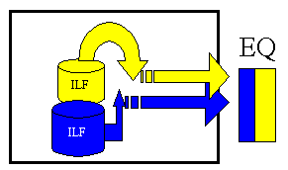
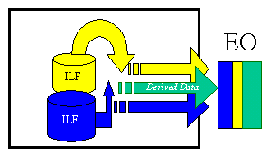
Components of Function Point - Transactions
External Inputs External Output External Inquires
After the components have been classified as one of the five major components (EI’s, EO’s, EQ’s, ILF’s or EIF’s), a ranking of low, average or high is assigned depending on the complexity.

Slide 28
Function Point (FP) Benefits
-Benefits :
Function Point Analysis can be used to determine whether a tool, an environment, a language is more productive compared with others
increase in productivity and
reduction in the risk of inflation of created code.

Slide 29
Direct Measurement: Lines of Code (LOC)
Lines of code/statements (LOC)
It is a software metric used to measure the size of a computer program by counting the number of lines in the text of the program's source code
Studies show correlation between LOC and the overall cost and length of development, and between LOC and number of defects.
The lower your LOC measurement is, the better it is.

Slide 30
Direct Measurement: Lines of Code (LOC)
Examples of use include:
productivity KLOC/person-month
quality faults/KLOC
cost $$/KLOC
documentation doc_pages/KLOC

Slide 31
LOC- Example
for (i = 0; i < 100; i += 1) { printf("hello"); } /* Now how many lines of code is this? */
In this example we have:
4 Physical Lines of Code (LOC)
2 Logical Line of Code (LLOC)
1 comment line

Slide 32
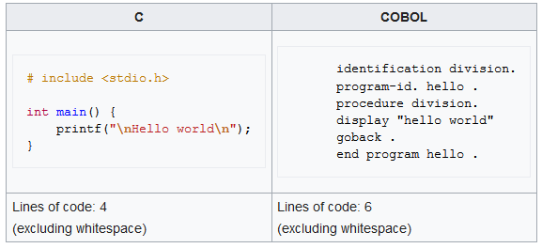
LOC- Example
The range is extraordinary: the average iPhone app has less than 50,000 lines of code, while Google's entire code base is two billion lines for all services.

Slide 33

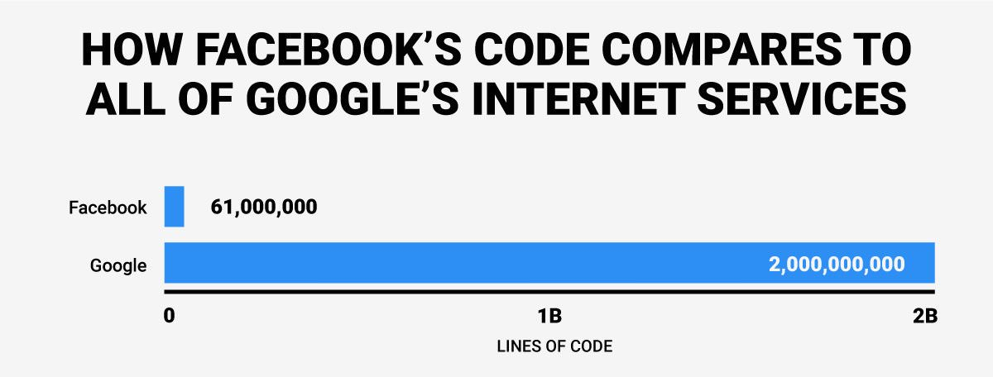

Slide 34
Estimation is the process of finding an estimate, or approximation. Determines how much money, effort, resources, and time it will take to build a system. Estimation is based on − Past Data/Past Experience Available Documents/Knowledge Assumptions Identified Risks The four basic steps in Software Project Estimation are − Estimate the size of the development product. Estimate the effort in person-months or person-hours. Estimate the schedule in calendar months. Estimate the project cost in agreed currency. - Make/Buy Decision - COCOMO II
Estimation Model

Slide 35
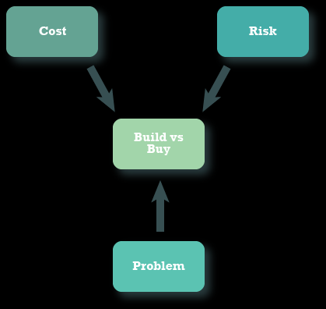
Make-or-Buy Decision
A make-or-buy decision is the act of choosing between manufacturing a product in-house or purchasing it from an external supplier.
Build to Compete. Buy to Standardize.

Slide 36
Make-or-Buy Decision
Options:
software may be purchased (or licensed) off-the shelf
“fully-experience” or “partially experience” software components may be acquired and then modified and integrated to meet specific needs.
software may be custom built by an outside contractor to meet the purchaser’s specification.

Slide 37
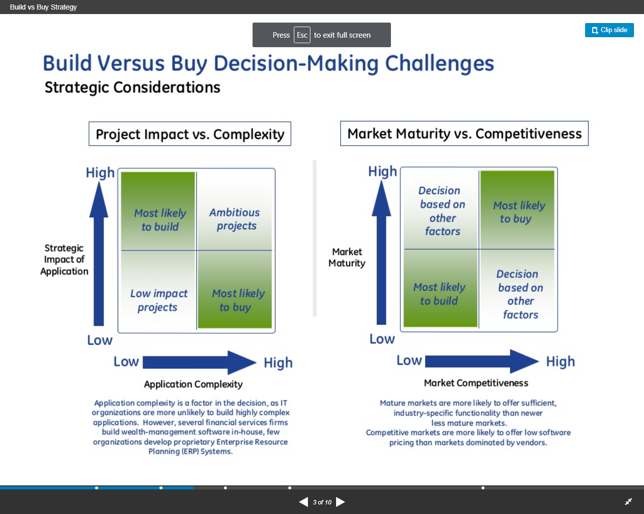
Make-or-Buy Decision : Strategic Considerations

Slide 38
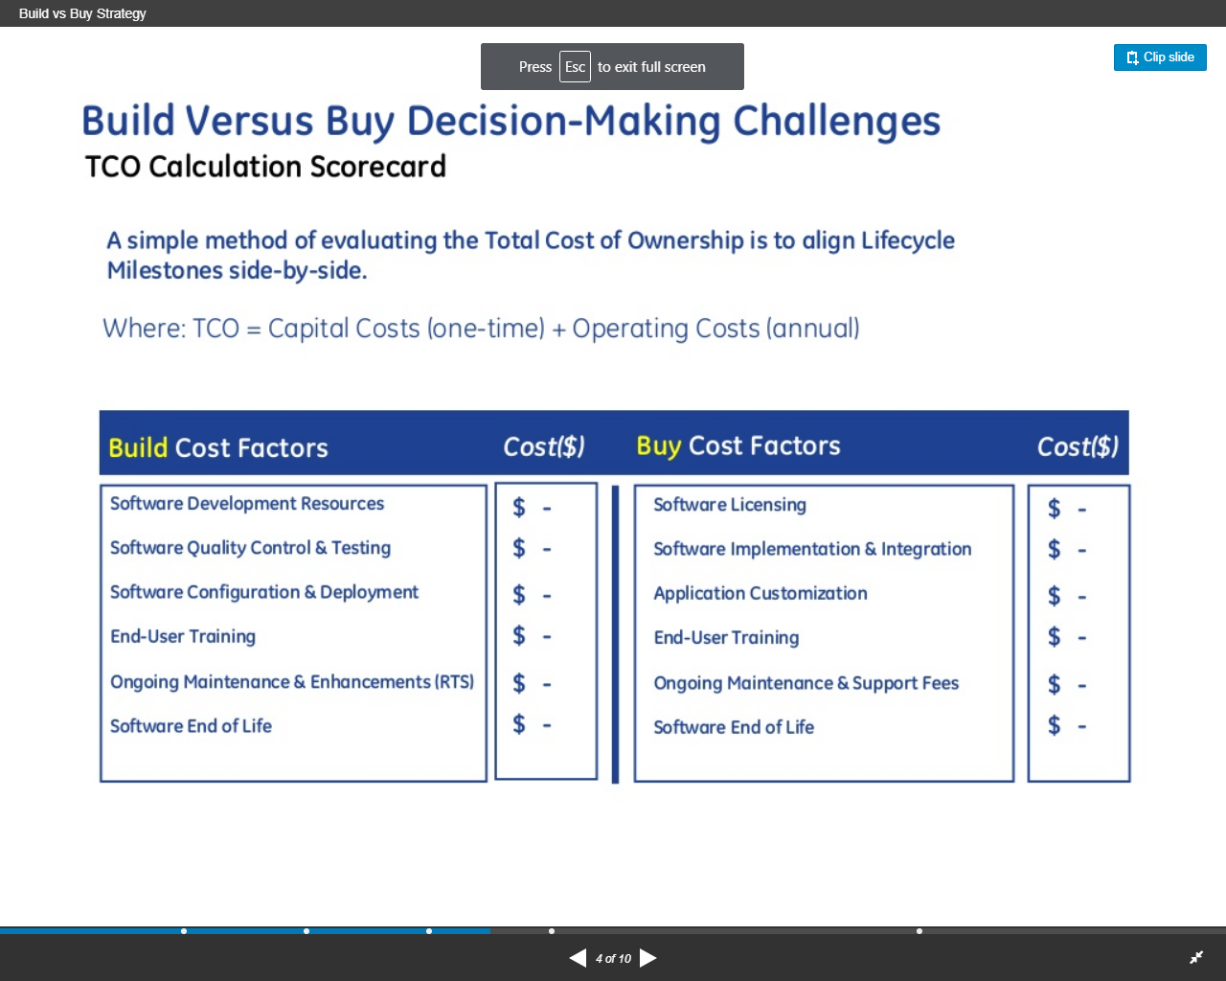
Make-or-Buy Decision : Evaluating Cost of Ownership

Slide 39
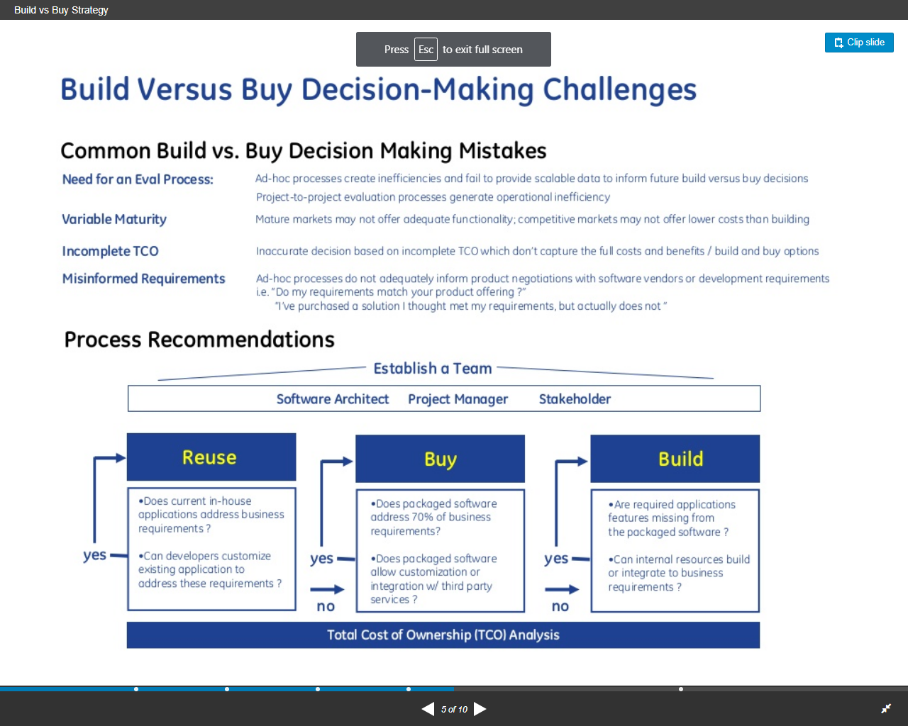
Make-or-Buy Decision : Process

Slide 40
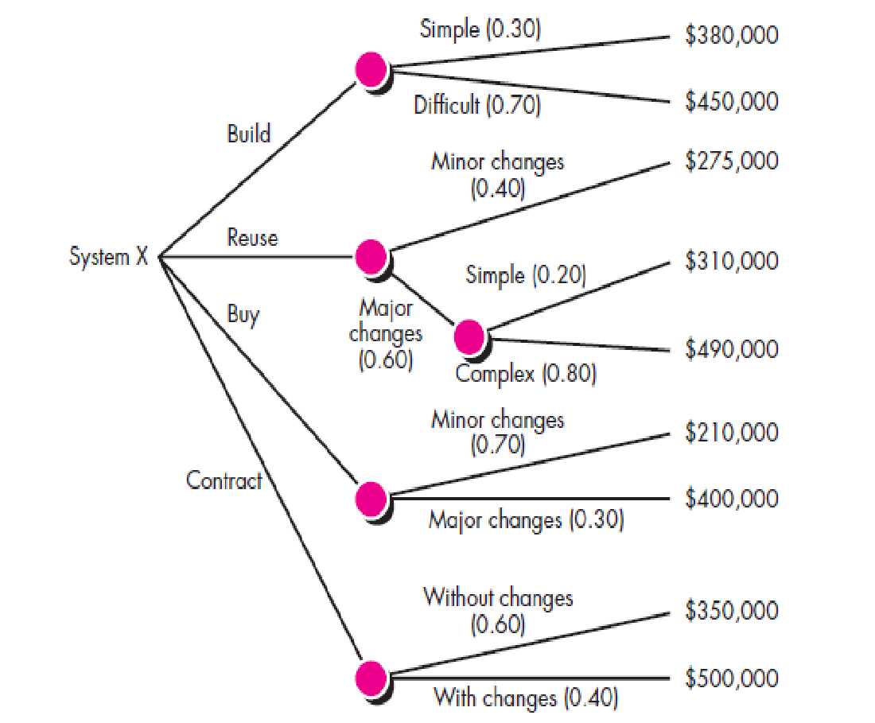
Creating a Decision Tree
Built system X from scratch.
reuse existing partial-experience components to contract the system.
Buy an available software product and modify it to meet local needs.
Contract the software development to an outside vendor.

Slide 41
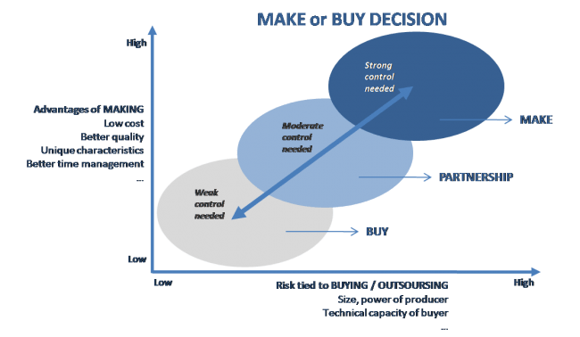
Make-or-Buy Decision

Slide 42
COCOMO II - Constructive Cost Model

Slide 43
COCOMO - Project Planning
The Constructive Cost Model (COCOMO) is a procedural software cost estimation model developed by Barry W. Boehm.

Slide 44
COCOMO-II by Barry Boehm
Has three types of model:-
Application Composition Model- Used during the early stages of software engineering.
Early design stage Model- Used once requirements have been stabilized and basic software architecture has been established .
Post-architecture stage Model –Used during the construction of the software.
The sizing information followed by this model is the direct software measure ‘object points’.

Slide 45
COCOMO II - Project Planning
Object Point is computed using counts of the number of
Screens (at the user interface)
Reports
Components likely to be printed to build the application.
Each object instance (e.g. a screen or report) is classified into one of three complexity levels (i.e. simple , medium, difficult)
In essence, complexity is a function of
Number and source of the client and server data tables that are required to generate the screen or report.
Number of views or sections presented as part of the screen or report.

Slide 46
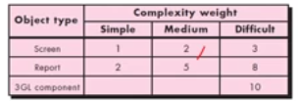
COCOMO II - Project Planning
Once complexity is determined, the number of screens reports, components are weighted according to following table:

Slide 47
COCOMO II - Project Planning
The object point count is then determined by multiplying the original number of object instances by the weighting factor in the figure and summing to obtain a total object point count.
When components based development or general software reuse is to be applied, the percent of reuse (% reuse) is estimated and the object point count is adjusted:
NOP= (object points) * [(100-%reuse)/100]
Where New Object Points NOP is defined as new object points.

Slide 48
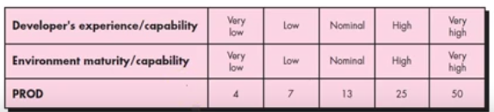
COCOMO II - Project Planning
Now the estimate of project effort is computed as follows:
Estimated effort= NOP/PROD
Productivity rate (PROD) can be derived from following table based on developer experience and organization maturity.

Slide 49
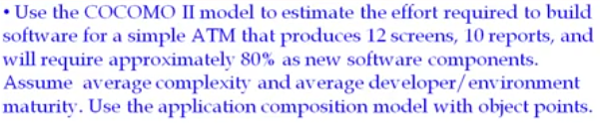
COCOMO II Example

Slide 50
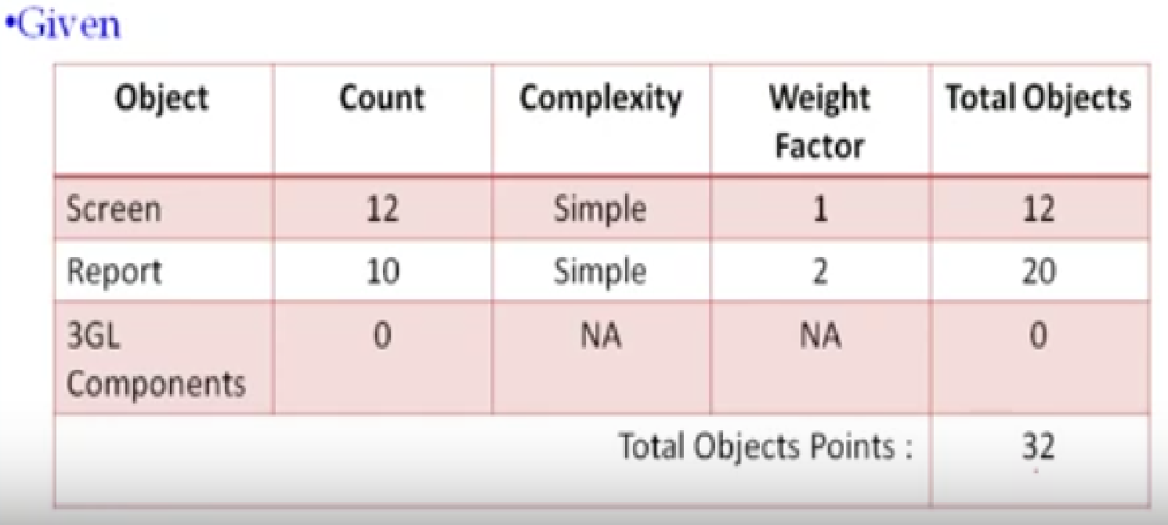
COCOMO II Example

Slide 51
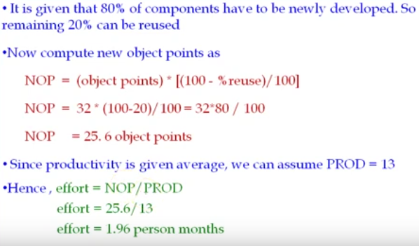
COCOMO II Example

Slide 52
COCOMO II Summary
Size of project can be listed as object points, function points or source lines of code (SLOC)
Notes:
Problems with CoCoMo II
Not developed for Web apps
Estimates driven by SLOC count

Slide 53
Example 2 :
For a given IIST airline sales system, at the early stage, we need 3 screens and 1 report:
a booking screen to record a new advertising sale booking
a pricing screen showing the advertising rate for each day and each flight
an availability screen showing which flights are available
1. a sales report showing total sales for the month and year, and comparing them with previous months and years
Consider the developer experience and organization maturity as very low and requires 70% as a new software component.
The booking screen is classified as simple. Similarly, the levels of difficulty of the pricing screen, the availability screen and the sales report are classified as simple, medium and medium respectively. There is no 3GL component.

Slide 54
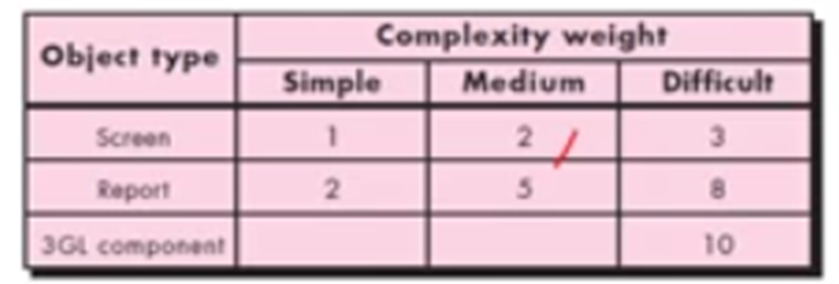
COCOMO II Example 2
Table 1 Ratings for IIST airline sales system
Objects Complexity Weight
Booking Screen (1) Simple 1
Pricing Screen (1) Simple 1
Availability Screen (1) Medium 2
Report (1) Medium 5
Total 9

Slide 55
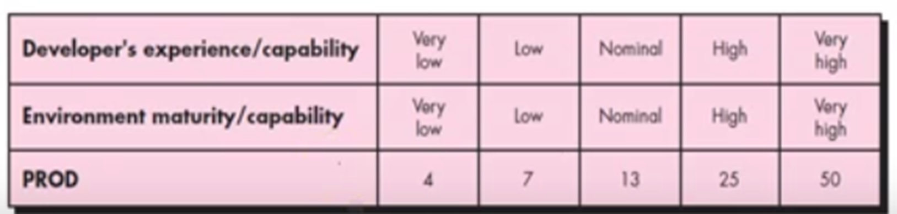
COCOMO II Example 2
NOP= (object points) * [(100-%reuse)/100]
NOP =9 * (100-30)/100
=9 * 0.7
= 6.3 object points.
Effort= NOP /PROD
= 6.3 / 4
= 1.575
According to COCOMO II, the project requires approx. 1.57 person-months.

Slide 56
SWOT Analysis

Slide 57
SWOT Analysis
Purpose of a SWOT Analysis:
The purpose is to get managers thinking about everything that could potentially impact the success of a new project.
It is a study undertaken by an organization to identify its internal strengths and weaknesses, as well as its external opportunities and threats.

Slide 58
SWOT Analysis
Objectives :
To make a summary analysis of external and internal factors.
To identify key items for the management of the organization, which involves establishing priorities for action.
To prepare strategic options: risks and problems to solve.
To conduct a sales forecast in agreement with market conditions and study the capabilities of the company in general.

Slide 59
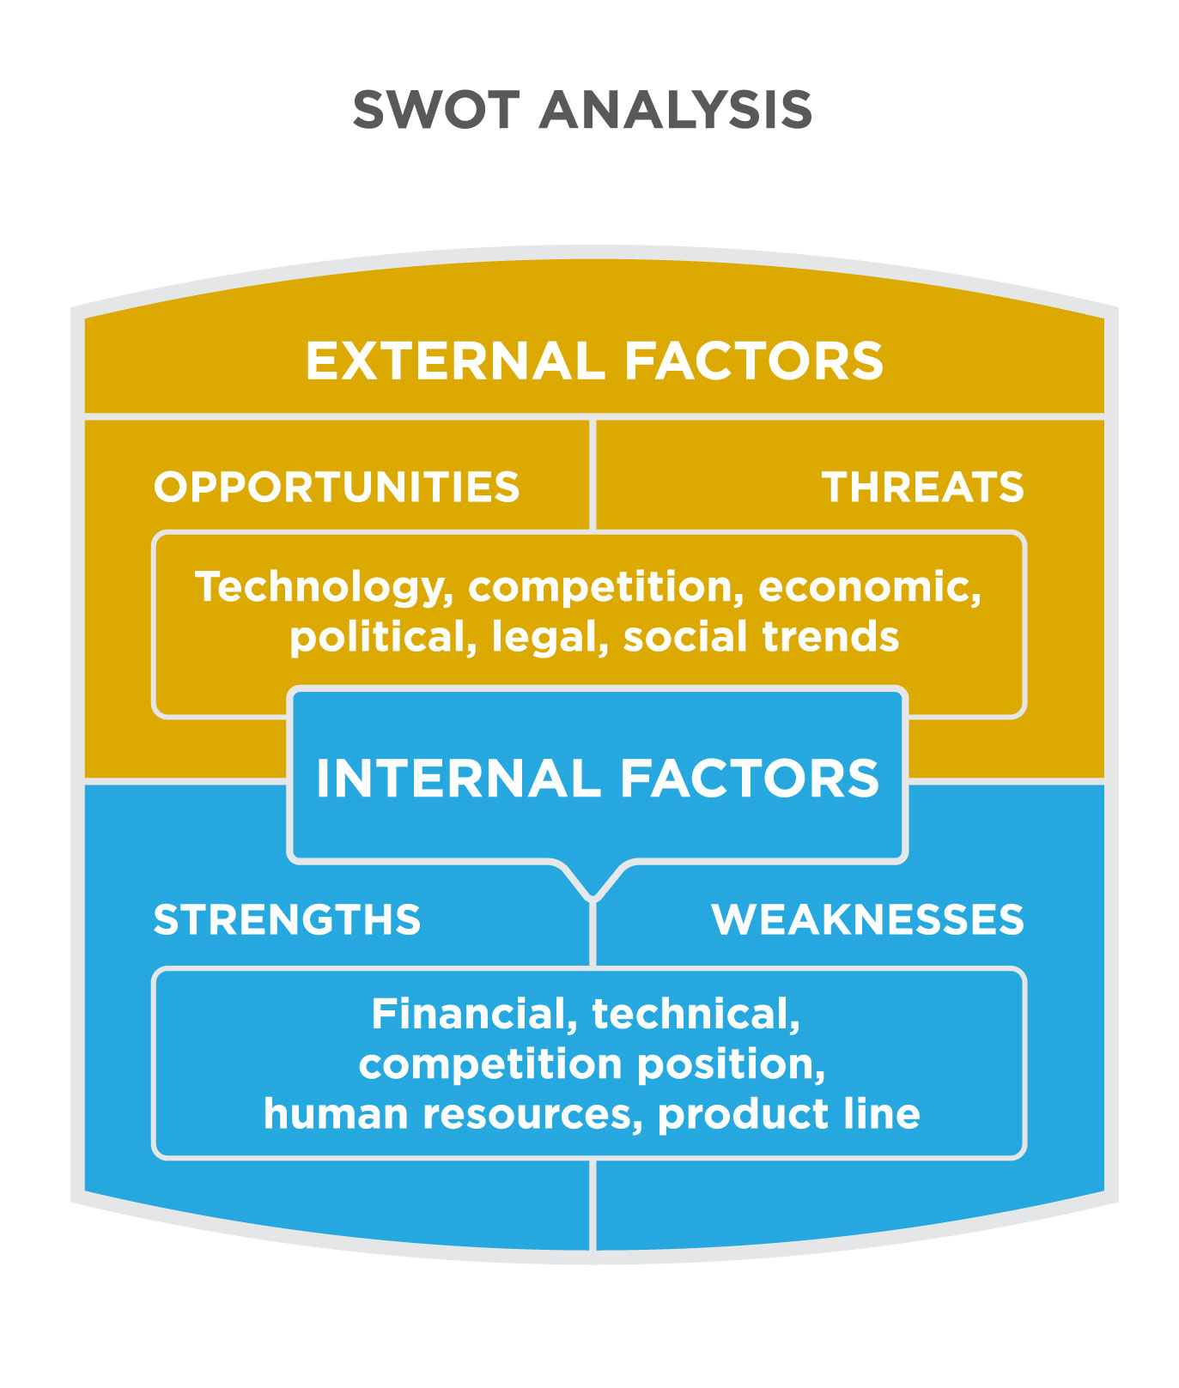
Internal and External Factors
Internal factors — the strengths and weaknesses internal to the organization.
External factors — the opportunities and threats presented by the environment external to the organization.

Slide 60
SWOT Analysis
Strengths: characteristics of the business or project that give it an advantage over others
Weaknesses: characteristics of the business that place the business or project at a disadvantage relative to others
Opportunities: elements in the environment that the business or project could exploit to its advantage
Threats: elements in the environment that could cause trouble for the business or project

Slide 61
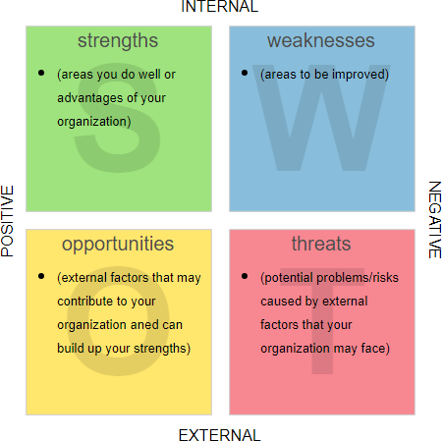
Example of SWOT Analysis

Slide 62
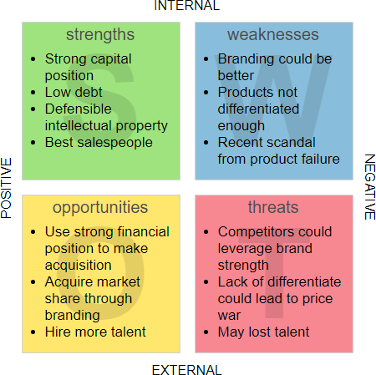
Example of SWOT Analysis

Slide 63

Functions of Manager

Slide 64
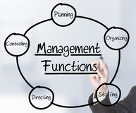
Functions of Manager
P- Planning
O- Organizing
S- Staffing
D- Directing
CO- Controlling
R- Reporting
B- Budgeting

Slide 65


Slide 66
PLANNING
Planning means setting an organization’s goal and deciding how best to achieve them.
Planning is decision making, regarding the goals and setting the future course of action from a set of alternatives to reach them.
The plan helps to maintain the managerial effectiveness as it works as a guide for the personnel for the future activities.

Slide 67


Slide 68
ORGANISING
Is the process of grouping together of men and establishing relationship among them, defining the authority and responsibility of personnel by using the company’s other basic resources to reach predetermined goals or objectives.

Slide 69


Slide 70
STAFFING
Filling and keeping filled with qualified people all positions in the nosiness.
Recruiting, hiring, training, evaluating and compensating are the specific activities included in the function.
In the family business, staffing includes all paid and unpaid positions held any family members including the owner/operators.

Slide 71
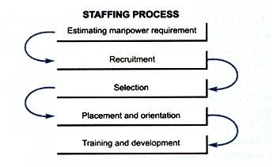
Staffing Process

Slide 72


Slide 73
DIRECTING
Refers to the process of motivation, communication and leadership.
The purpose of directing is to channel the behavior of all personnel to accomplish the organization’s mission and objectives while simultaneously helping them.

Slide 74


CONTROLLING
Process of evaluating and correcting activities to keep organization on course.
Measuring performance
Comparing performance against standards
Identifying deviation from standards
Investigating causes of deviations
Taking Corrective Action

Slide 75
Reporting
It includes daily follow up of activities with help of reports which are submitted by subordinates to his/her superior.
Reporting keeps him/her informed with day to day activities.

Slide 76
Budgeting
Budget is an estimate of future needs covering all the activities of an enterprise for a definite period of time.
A budget is prepared for each separate activity of business.
This is done to control the expenses of organizations within certain limit.

Slide 77

Team Building & Development

Slide 78

Team Building and Development
Selecting the project Team
At what point is the project team formed?
Who should select the project team?
What types of people should be on the team?
How do the team members get started?

Slide 79

Choosing Effective Team Leader
Excellent Communicator
Knowledge of Project Management Principles
Highly Organized
Strong Ability to Read People
Accurate Estimating Skills
Self-Assured

Slide 80

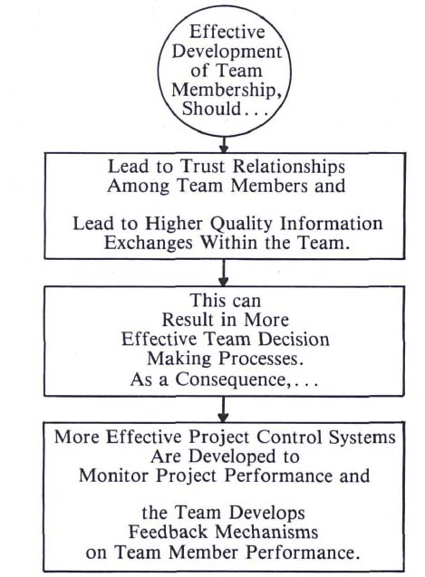

Slide 81
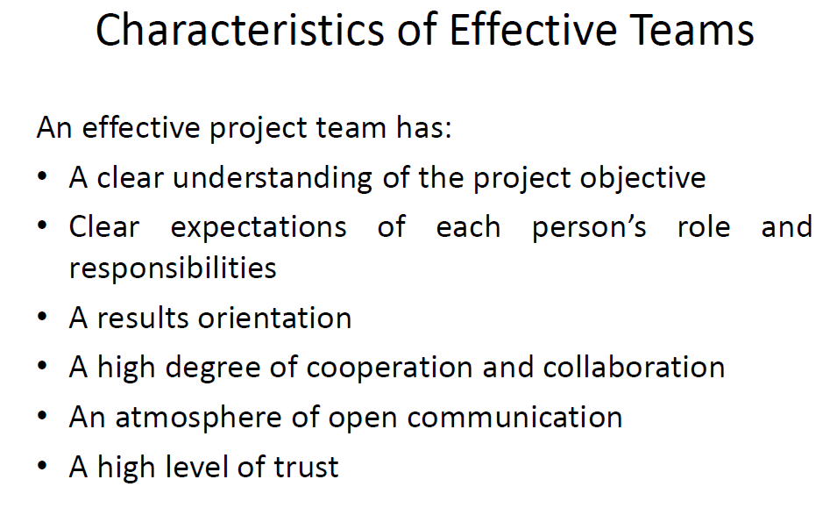

Slide 82
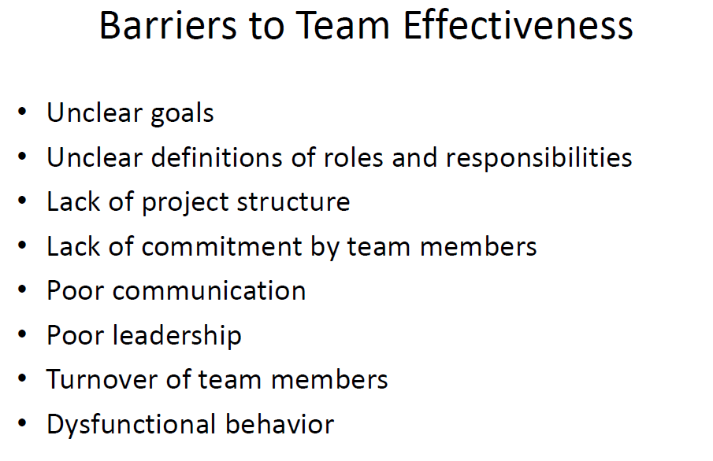

Slide 83
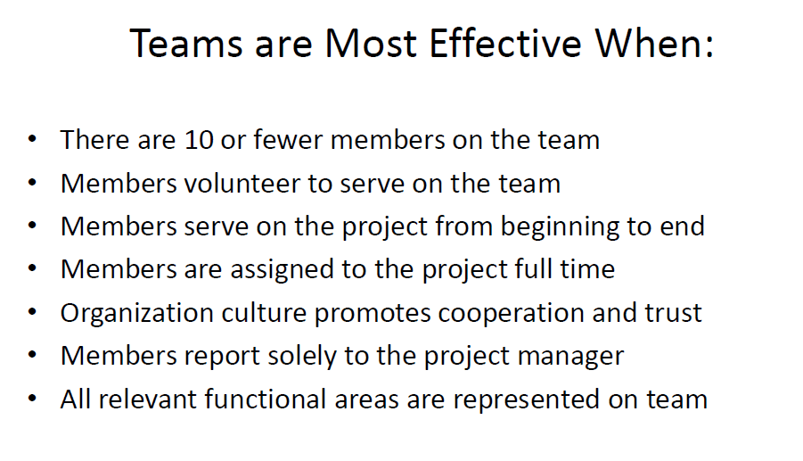

Slide 84
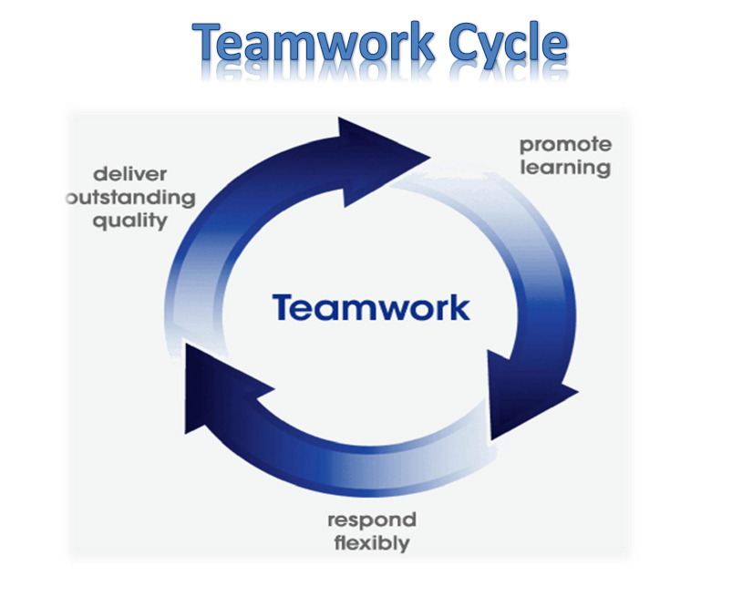

Slide 85


Slide 86
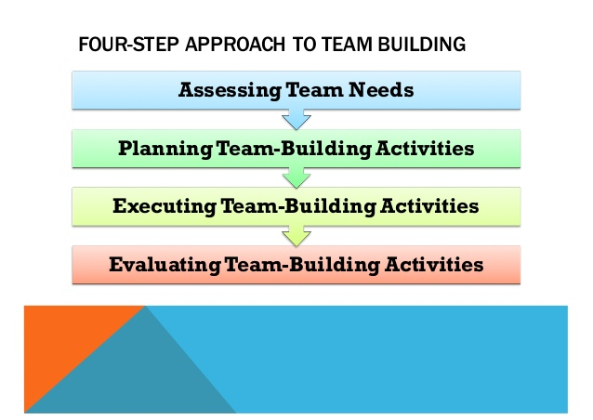
Team Building

Slide 87
Team Building -Assess
Look for strengths and weaknesses in team members
For a team to be successful the following characteristics are needed:
A clear direction that is understood by all team members
Team players
Understood and accepted accountability measures.

Slide 88
Team Building - Plan
Planning
Based on the results of needs assessment
Activities should be based on the strengths and weaknesses of the needs assessment.

Slide 89
Team Building - Execute
Execution
Just-in-time
Continuous improvement

Slide 90
Team Building - Evaluate
Evaluation
Effectiveness can be measured based on how well weaknesses identified in the needs assessment were strengthened.
Re-administer the needs assessment.

Slide 91
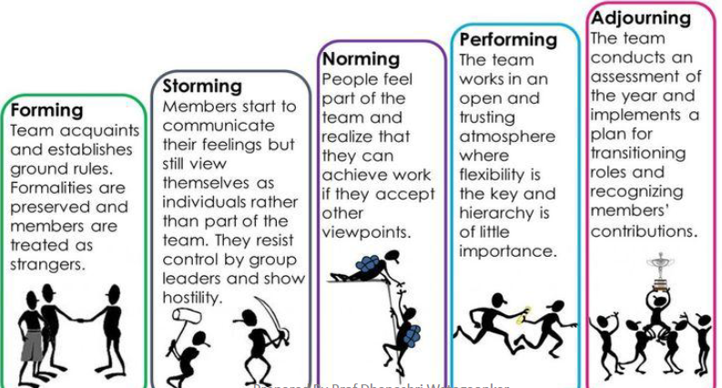
Stages of Team Development

Slide 92
Risk management means risk containment and mitigation. First, you’ve got to identify and plan. Then be ready to act when a risk arises, drawing upon the experience and knowledge of the entire team to minimize the impact to the project.
Risk Management

Slide 93
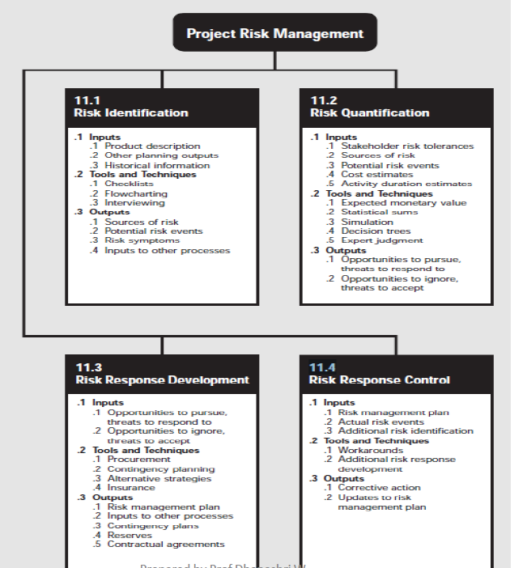
Risk Management

Slide 94
Risk Management
Risk Identification- determining which risks are likely to affect the project and documenting the characteristics of each.
Risk Quantification- evaluating risks and risk interactions to assess the range of possible project outcomes.
Risk Response Development- defining enhancement steps for opportunities and responses to threats.
Risk Response Control- responding to changes in risk over the course of project.

Slide 95
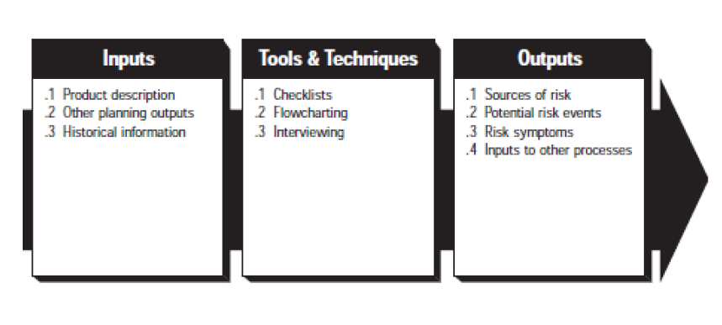
Risk Identification

Slide 96
Inputs
Inputs
Product description
Other planning outputs:
WBS
Cost Estimates
Staffing plan
Procurement management plan
Historical Information
Notes:
Product description: The nature of the product of the project will have a major effect on the risks identified. Products that involve proven technology will, all other
things being equal, involve less risk than products which require innovation or invention. The nature of the product of the project will have a major effect
on the risks identified. Products that involve proven technology will, all other things being equal, involve less risk than products which require innovation or invention. Risks associated with the product of the project are often described in terms of their cost and schedule impact.
Other planning outputs: The outputs of the processes in other knowledge areas should be reviewed to identify possible risks.
For example:
• Work breakdown structure—non-traditional approaches to detail deliverables may offer opportunities that were not apparent from the higher-level deliverables
identified in the scope statement.
• Cost estimates and duration estimates—aggressive estimates and estimates developed with a limited amount of information entail more risk.
• Staffing plan—identified team members may have unique skills that would be hard to replace or may have other commitments that make their availability
tenuous.
• Procurement management plan—market conditions such as a sluggish local economy may offer opportunities to reduce contract costs.
3 Historical information. Historical information about what actually happened on previous projects can be especially helpful in identifying potential risks. Information on historical results is often available from the following sources:
• Project files—one or more of the organizations involved in the project may maintain records of previous project results that are detailed enough to aid in
risk identification. In some application areas, individual team members may maintain such records.
• Commercial databases—historical information is available commercially in many application areas.
• Project team knowledge—the individual members of the project team may remember previous occurrences or assumptions. While such recollections may
be useful, they are generally less reliable than documented results.

Slide 97
Product description: The nature of the product of the project will have a major effect on the risks identified. Products that involve proven technology will, all other
things being equal, involve less risk than products which require innovation or invention. The nature of the product of the project will have a major effect
on the risks identified. Products that involve proven technology will, all other things being equal, involve less risk than products which require innovation or invention. Risks associated with the product of the project are often described in terms of their cost and schedule impact.
Other planning outputs: The outputs of the processes in other knowledge areas should be reviewed to identify possible risks.
For example:
• Work breakdown structure—non-traditional approaches to detail deliverables may offer opportunities that were not apparent from the higher-level deliverables
identified in the scope statement.
• Cost estimates and duration estimates—aggressive estimates and estimates developed with a limited amount of information entail more risk.
• Staffing plan—identified team members may have unique skills that would be hard to replace or may have other commitments that make their availability
tenuous.
• Procurement management plan—market conditions such as a sluggish local economy may offer opportunities to reduce contract costs.

Slide 98
3 Historical information. Historical information about what actually happened on previous projects can be especially helpful in identifying potential risks. Information on historical results is often available from the following sources:
• Project files—one or more of the organizations involved in the project may maintain records of previous project results that are detailed enough to aid in
risk identification. In some application areas, individual team members may maintain such records.
• Commercial databases—historical information is available commercially in many application areas.
• Project team knowledge—the individual members of the project team may remember previous occurrences or assumptions. While such recollections may
be useful, they are generally less reliable than documented results.

Slide 99
Tools & Techniques
Checklists
Flowcharting
Interviewing : Risk oriented interviews with various stakeholders.
Checklists. Checklists are typically organized by source of risk. Sources include the project context , other process outputs, the product of the project or technology issues, and internal sources such as team member skills (or the lack thereof). Some application areas have widely used classification schemes for sources of risk.
Flowcharting. Flowcharting can help the project team better understand the causes and effects of risks.
Interviewing. Risk-oriented interviews with various stakeholders may help identify risks not identified during normal planning activities. Records of pre-project interviews (e.g., those conducted during a feasibility study) may also be available.
Notes:
Checklists. Checklists are typically organized by source of risk. Sources include the project context , other process outputs, the product of the project or technology issues, and internal sources such as team member skills (or the lack thereof). Some application areas have widely used classification schemes for sources of risk.
Flowcharting. Flowcharting can help the project team better understand the causes and effects of risks.
Interviewing. Risk-oriented interviews with various stakeholders may help identify risks not identified during normal planning activities. Records of pre-project interviews (e.g., those conducted during a feasibility study) may also be available.

Slide 100
Outputs
Sources of risk
- Change in requirements
- Design errors , omissions and misunderstandings
- Poorly defined or understand roles and responsibilities
- Poor estimates
- Insufficient skilled staff
Possible risk events
Risk symptoms
Inputs to other processes
Notes:
Sources of risk. Sources of risk are categories of possible risk events (e.g., stakeholder actions, unreliable estimates, team turnover) that may affect the project for
better or worse. The list of sources should be comprehensive, i.e., it should generally include all identified items regardless of frequency, probability of occurrence,
or magnitude of gain or loss. Common sources of risk include:
• Changes in requirements.
• Design errors, omissions, and misunderstandings.
• Poorly defined or understood roles and responsibilities.
• Poor estimates.
• Insufficiently skilled staff.
Descriptions of the sources of risk should generally include estimates of (a) the probability that a risk event from that source will occur, (b) the range of possible outcomes, (c) expected timing, and (d) anticipated frequency of risk events from that source.
Both probabilities and outcomes may be specified as continuous functions (an estimated cost between $100,000 and $150,000) or as discrete ones (a patent either
will or will not be granted). In addition, estimates of probabilities and outcomes made during early project phases are likely to have a broader range than those made later in the project.
Potential risk events. Potential risk events are discrete occurrences such as a natural disaster or the departure of a specific team member that may affect the project. Potential risk events should be identified in addition to sources of risk when the probability of occurrence or magnitude of loss is relatively large (“relatively large” will vary by project). While potential risk events are seldom application-area-specific, a list of common risk events usually is. For example:
• Development of new technology that will obviate the need for a project is common in electronics and rare in real estate development.
• Losses due to a major storm are common in construction and rare in biotechnology.
Descriptions of potential risk events should generally include estimates of (a) the probability that the risk event will occur, (b) the alternative possible outcomes, (c)
expected timing of the event, and (d) anticipated frequency (i.e., can it happen more than once). Both probabilities and outcomes may be specified as continuous functions (an estimated cost between $100,000 and $150,000) or as discrete ones (a patent either will or will not be granted). In addition, estimates of probabilities and outcomes made during early project phases are likely to have a broader range than those made later in the project.
Risk symptoms. Risk symptoms, sometimes called triggers, are indirect manifestations of actual risk events. For example, poor morale may be an early warning signal of an impending schedule delay or cost overruns on early activities may be indicative of poor estimating.
.4 Inputs to other processes. The risk identification process may identify a need for further activity in another area. For example, the work breakdown structure may not have sufficient detail to allow adequate identification of risks. Risks are often input to the other processes as constraints or assumptions.

Slide 101
Sources of risk. Sources of risk are categories of possible risk events (e.g., stakeholder actions, unreliable estimates, team turnover) that may affect the project for
better or worse. The list of sources should be comprehensive, i.e., it should generally include all identified items regardless of frequency, probability of occurrence,
or magnitude of gain or loss. Common sources of risk include:
• Changes in requirements.
• Design errors, omissions, and misunderstandings.
• Poorly defined or understood roles and responsibilities.
• Poor estimates.
• Insufficiently skilled staff.
Descriptions of the sources of risk should generally include estimates of (a) the probability that a risk event from that source will occur, (b) the range of possible outcomes, (c) expected timing, and (d) anticipated frequency of risk events from that source.
Both probabilities and outcomes may be specified as continuous functions (an estimated cost between $100,000 and $150,000) or as discrete ones (a patent either
will or will not be granted). In addition, estimates of probabilities and outcomes made during early project phases are likely to have a broader range than those made later in the project.

Slide 102
Potential risk events. Potential risk events are discrete occurrences such as a natural disaster or the departure of a specific team member that may affect the project. Potential risk events should be identified in addition to sources of risk when the probability of occurrence or magnitude of loss is relatively large (“relatively large” will vary by project). While potential risk events are seldom application-area-specific, a list of common risk events usually is. For example:
• Development of new technology that will obviate the need for a project is common in electronics and rare in real estate development.
• Losses due to a major storm are common in construction and rare in biotechnology.
Descriptions of potential risk events should generally include estimates of (a) the probability that the risk event will occur, (b) the alternative possible outcomes, (c)
expected timing of the event, and (d) anticipated frequency (i.e., can it happen more than once). Both probabilities and outcomes may be specified as continuous functions (an estimated cost between $100,000 and $150,000) or as discrete ones (a patent either will or will not be granted). In addition, estimates of probabilities and outcomes made during early project phases are likely to have a broader range than those made later in the project.
Risk symptoms. Risk symptoms, sometimes called triggers, are indirect manifestations of actual risk events. For example, poor morale may be an early warning signal of an impending schedule delay or cost overruns on early activities may be indicative of poor estimating.
.4 Inputs to other processes. The risk identification process may identify a need for further activity in another area. For example, the work breakdown structure may not have sufficient detail to allow adequate identification of risks. Risks are often input to the other processes as constraints or assumptions.

Slide 103
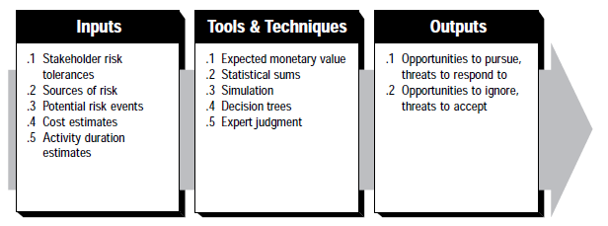
Risk Quantification

Slide 104
Risk Quantification
Inputs
Stakeholder risk tolerance: Different organizations and different individuals have different tolerances for risk.
Source of risk
Potential risk events
Cost estimates
Activity duration estimates.
Stakeholder risk tolerances. Different organizations and different individuals have different tolerances for risk. For example:
• A highly profitable company may be willing to spend $500,000 to write a proposal for a $1 billion contract, while a company operating at break-even is not.
• One organization may perceive an estimate that has a 15 percent probability of overrunning as high risk, while another perceives it as low risk. Stakeholder risk tolerances provide a screen for both inputs and outputs to risk quantification.
Notes:
Stakeholder risk tolerances. Different organizations and different individuals have different tolerances for risk.
For example:
• A highly profitable company may be willing to spend $500,000 to write a proposal for a $1 billion contract, while a company operating at break-even is not.
• One organization may perceive an estimate that has a 15 percent probability of overrunning as high risk, while another perceives it as low risk.
Stakeholder risk tolerances provide a screen for both inputs and outputs to risk quantification.

Slide 105
Tools & Techniques
Expected monetary value.
• Risk event probability—an estimate of the probability that a given risk event will occur.
• Risk event value—an estimate of the gain or loss that will be incurred if the risk event does occur.
Statistical sums. The range of total project costs can be used to quantify the relative risk of alternative project budgets or proposal prices.
Simulation: It uses a representation or model of a system to analyze the behavior or performance of the system.
Decision trees. A decision tree is a diagram that depicts key interactions among decisions and associated chance events as they are understood by the decision maker.
Expert judgment. Risk events could be described as having a high, medium, or low probability of occurrence
Notes:
Tools and Techniques for Risk Quantification
Expected monetary value. Expected monetary value, as a tool for risk quantification, is the product of two numbers:
• Risk event probability—an estimate of the probability that a given risk event will occur.
• Risk event value—an estimate of the gain or loss that will be incurred if the risk event does occur.
The risk event value must reflect both tangibles and intangibles. For example, Project A and Project B both identify an equal probability of a tangible loss of
$100,000 as an outcome of an aggressively priced proposal. If Project A predicts little or no intangible effect, while Project B predicts that such a loss will put its performing organization out of business, the two risks are not equivalent. In similar fashion, failure to include intangibles in this calculation can severely
distort the result by equating a small loss with a high probability to a large loss with a small probability. The expected monetary value is generally used as input to further analysis (e.g., in a decision tree) since risk events can occur individually or in groups, in parallel or in sequence.
Statistical sums. Statistical sums can be used to calculate a range of total project costs from the cost estimates for individual work items. (Calculating a range of probable project completion dates from the activity duration estimates requires simulation. The range of total project costs can be used to quantify the relative risk of alternative project budgets or proposal prices.
Simulation. Simulation uses a representation or model of a system to analyze the behavior or performance of the system. The most common form of simulation on a project is schedule simulation using the project network as the model of the project. Most schedule simulations are based on some form of Monte Carlo analysis. This technique, adapted from general management, “performs” the project many times to provide a statistical distribution of the calculated results.
The results of a schedule simulation may be used to quantify the risk of various schedule alternatives, different project strategies, different paths through the network, or individual activities.
Schedule simulation should be used on any large or complex project since traditional mathematical analysis techniques such as the Critical Path Method (CPM)
and the Program Evaluation and Review Technique (PERT) do not account for path convergence and thus tend to underestimate project durations. Monte Carlo analysis and other forms of simulation can also be used to assess the range of possible cost outcomes.
Decision trees. A decision tree is a diagram that depicts key interactions among decisions and associated chance events as they are understood by the decision maker. The branches of the tree represent either decisions (shown as boxes) or chance events.
Expert judgment. Expert judgement can often be applied in lieu of or in addition to the mathematical techniques described above. For example, risk events could be described as having a high, medium, or low probability of occurrence and a severe, moderate, or limited impact.

Slide 106
Tools and Techniques for Risk Quantification
Expected monetary value. Expected monetary value, as a tool for risk quantification, is the product of two numbers:
• Risk event probability—an estimate of the probability that a given risk event will occur.
• Risk event value—an estimate of the gain or loss that will be incurred if the risk event does occur.
The risk event value must reflect both tangibles and intangibles. For example, Project A and Project B both identify an equal probability of a tangible loss of
$100,000 as an outcome of an aggressively priced proposal. If Project A predicts little or no intangible effect, while Project B predicts that such a loss will put its performing organization out of business, the two risks are not equivalent. In similar fashion, failure to include intangibles in this calculation can severely
distort the result by equating a small loss with a high probability to a large loss with a small probability. The expected monetary value is generally used as input to further analysis (e.g., in a decision tree) since risk events can occur individually or in groups, in parallel or in sequence.
Statistical sums. Statistical sums can be used to calculate a range of total project costs from the cost estimates for individual work items. (Calculating a range of probable project completion dates from the activity duration estimates requires simulation. The range of total project costs can be used to quantify the relative risk of alternative project budgets or proposal prices.

Slide 107
Simulation. Simulation uses a representation or model of a system to analyze the behavior or performance of the system. The most common form of simulation on a project is schedule simulation using the project network as the model of the project. Most schedule simulations are based on some form of Monte Carlo analysis. This technique, adapted from general management, “performs” the project many times to provide a statistical distribution of the calculated results.
The results of a schedule simulation may be used to quantify the risk of various schedule alternatives, different project strategies, different paths through the network, or individual activities.
Schedule simulation should be used on any large or complex project since traditional mathematical analysis techniques such as the Critical Path Method (CPM)
and the Program Evaluation and Review Technique (PERT) do not account for path convergence and thus tend to underestimate project durations. Monte Carlo analysis and other forms of simulation can also be used to assess the range of possible cost outcomes.
Decision trees. A decision tree is a diagram that depicts key interactions among decisions and associated chance events as they are understood by the decision maker. The branches of the tree represent either decisions (shown as boxes) or chance events.
Expert judgment. Expert judgement can often be applied in lieu of or in addition to the mathematical techniques described above. For example, risk events could be described as having a high, medium, or low probability of occurrence and a severe, moderate, or limited impact.

Slide 108
Outputs
Opportunities to pursue, threats to respond to: The major output from risk qualification is a list of opportunities that should be pursued and threats that require attention.
Opportunities to ignore, threats to accepts: The risk quantification process should also document
Those sources of risk and risk events that the project management team has consciously decided to accept or ignore.
Who made the decision to do so.

Slide 109
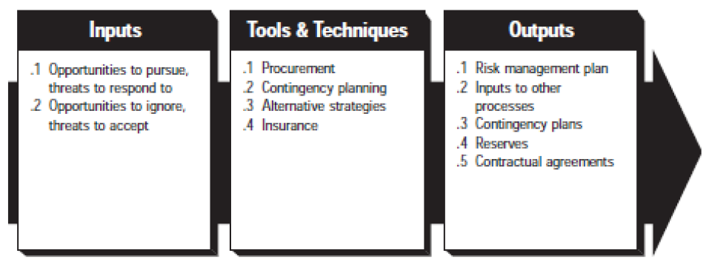
Risk Response Development

Slide 110
Inputs
Opportunities to pursue, threats to respond to
Opportunities to ignore, threats to accepts

Slide 111
Tools & Techniques
Procurement
Contingency planning
Alternative Strategies: Risk event can often be prevented or avoided by changing the planned approach
Insurance.
Notes:
Procurement. Procurement, acquiring goods or services from outside the immediate project organization, is often an appropriate response to some types of risk. For example, risks associated with using a particular technology may be mitigated by contracting with an organization that has experience with that technology.
Procurement often involves exchanging one risk for another. For example, mitigating cost risk with a fixed price contract may create schedule risk if the seller is
unable to perform. In similar fashion, trying to transfer all technical risk to the seller may result in an unacceptably high cost proposal.
Contingency planning. Contingency planning involves defining action steps to be taken if an identified risk event should occur (see also the discussion of workarounds.
Alternative strategies. Risk events can often be prevented or avoided by changing the planned approach. For example, additional design work may decrease the number of changes which must be handled during the implementation or construction phase. Many application areas have a substantial body of literature on the potential value of various alternative strategies.
Insurance. Insurance or an insurance-like arrangement such as bonding is often available to deal with some categories of risk. The type of coverage available and
the cost of coverage varies by application area.

Slide 112
Procurement. Procurement, acquiring goods or services from outside the immediate project organization, is often an appropriate response to some types of risk. For example, risks associated with using a particular technology may be mitigated by contracting with an organization that has experience with that technology.
Procurement often involves exchanging one risk for another. For example, mitigating cost risk with a fixed price contract may create schedule risk if the seller is
unable to perform. In similar fashion, trying to transfer all technical risk to the seller may result in an unacceptably high cost proposal.
Contingency planning. Contingency planning involves defining action steps to be taken if an identified risk event should occur (see also the discussion of workarounds.
Alternative strategies. Risk events can often be prevented or avoided by changing the planned approach. For example, additional design work may decrease the number of changes which must be handled during the implementation or construction phase. Many application areas have a substantial body of literature on the potential value of various alternative strategies.
Insurance. Insurance or an insurance-like arrangement such as bonding is often available to deal with some categories of risk. The type of coverage available and
the cost of coverage varies by application area.

Slide 113
Outputs
Risk management plan. It should document the procedure that will be used to managed risk throughout the project.
Inputs to other processes. Suggested alternative strategies, contingency plans, anticipated procurements, and other risk-related outputs must all be feedback.
Contingency plans. Contingency plans are pre-defined action steps to be taken if an identified risk event should occur.
Reserves. A reserve is a provision in the project plan to mitigate cost and/or schedule risk.
Contractual agreements. Insurance, services.
Notes:
Risk management plan. The risk management plan should document the procedures that will be used to manage risk throughout the project. In addition to documenting the results of the risk identification and risk quantification processes, it should cover who is responsible for managing various areas of risk, how the initial identification and quantification outputs will be maintained, how contingency plans will be implemented, and how reserves will be allocated.
A risk management plan may be formal or informal, highly detailed or broadly framed, based on the needs of the project. It is a subsidiary element of the overall
project plan.
Inputs to other processes. Selected or suggested alternative strategies, contingency plans, anticipated procurements, and other risk-related outputs must all be fed back into the appropriate processes in the other knowledge areas.
Contingency plans. Contingency plans are pre-defined action steps to be taken if an identified risk event should occur. Contingency plans are generally part of the risk management plan, but they may also be integrated into other parts of the overall project plan (e.g., as part of a scope management plan or quality management plan).
Reserves. A reserve is a provision in the project plan to mitigate cost and/or schedule risk. The term is often used with a modifier (e.g., management reserve, contingency reserve, schedule reserve) to provide further detail on what types of risk are meant to be mitigated. The specific meaning of the modified terms often varies by application area. In addition, use of a reserve, and the definition of what may be included in a reserve, is also application-area-specific.

Slide 114
Risk management plan. The risk management plan should document the procedures that will be used to manage risk throughout the project. In addition to documenting the results of the risk identification and risk quantification processes, it should cover who is responsible for managing various areas of risk, how the initial identification and quantification outputs will be maintained, how contingency plans will be implemented, and how reserves will be allocated.
A risk management plan may be formal or informal, highly detailed or broadly framed, based on the needs of the project. It is a subsidiary element of the overall
project plan.
Inputs to other processes. Selected or suggested alternative strategies, contingency plans, anticipated procurements, and other risk-related outputs must all be fed back into the appropriate processes in the other knowledge areas.
Contingency plans. Contingency plans are pre-defined action steps to be taken if an identified risk event should occur. Contingency plans are generally part of the risk management plan, but they may also be integrated into other parts of the overall project plan (e.g., as part of a scope management plan or quality management plan).
Reserves. A reserve is a provision in the project plan to mitigate cost and/or schedule risk. The term is often used with a modifier (e.g., management reserve, contingency reserve, schedule reserve) to provide further detail on what types of risk are meant to be mitigated. The specific meaning of the modified terms often varies by application area. In addition, use of a reserve, and the definition of what may be included in a reserve, is also application-area-specific.

Slide 115
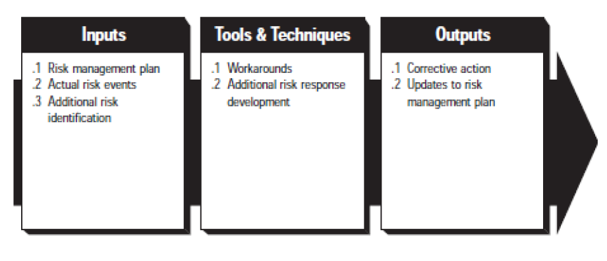
Risk Response Control

Slide 116
Inputs
Risk management plan
Actual risk events
Additional risk identification

Slide 117
Tools & Techniques
Workarounds: Workarounds are unplanned responses to negative risk events means the responses was not defined in advanced of the risk event occurring.
Additional risk response development: If the effect is grater than expected, the planned responses may not be adequate and it will be necessary to repeat the response development process and perhaps the risk quantification process as well.

Slide 118
Outputs
Corrective action
Updates to risk management plan
Corrective action. Corrective action consists primarily of performing the planned risk response (e.g., implementing contingency plans or workarounds).
Updates to risk management plan. As anticipated risk events occur or fail to occur, and as actual risk event effects are evaluated, estimates of probabilities and value, as well as other aspects of the risk management plan, should be updated
Notes:
Corrective action. Corrective action consists primarily of performing the planned risk response (e.g., implementing contingency plans or workarounds).
Updates to risk management plan. As anticipated risk events occur or fail to occur, and as actual risk event effects are evaluated, estimates of probabilities and value, as well as other aspects of the risk management plan, should be updated

Slide 119
Gantt Chart
Gantt charts are useful for planning and scheduling projects. They help you assess how long a project should take, determine the resources needed, and plan the order in which you'll complete tasks. They're also helpful for managing the dependencies between tasks.
A Gantt Chart is a timeline that is used as a project management tool to illustrate how the project will run. You can view individual tasks, their durations and the sequencing of these tasks. View the overall timeline of the project and the expected completion date.
A Gantt Chart is a horizontal bar chart that visually represents a project plan over time. Modern gantt charts typically show you the status of—as well as who's responsible for—each task in the project. Gantt charts contain the following features: Start and end dates for tasks

Slide 120
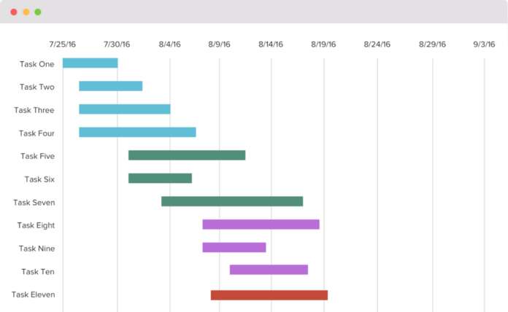
Gantt Chart

Slide 121
References
[1] https://www.simplilearn.com/project-and-process-metrics-article
[2] https://www.youtube.com/watch?v=mx3DejbTnSQ
[3] https://online.visual-paradigm.com/tutorials/swot-analysis-tutorial/
[4] https://webcache.googleusercontent.com/search?q=cache:YZXp7NA4mocJ:https://www8.cs.umu.se/kurser/TDBB12/HT05/Lectures/PVKHT05project%2520management.ppt+&cd=10&hl=en&ct=clnk&gl=in
[5]https://webcache.googleusercontent.com/search?q=cache:J-emu92YVAQJ:https://www.softwareresearch.net/fileadmin/src/docs/teaching/SS06/PM/PMBOK11.PDF+&cd=9&hl=en&ct=clnk&gl=in
[6] https://en.wikipedia.org/wiki/Source_lines_of_code
[7] https://www.slideshare.net/nagendraamatya/applied-research-methodology-lecture-1-10496165

Slide 122
